Slide 1
Case Studies of Community College ESOL Programs and the
Experiences of English Learners
Julia Raufman
Research Associate
AERA Conference, April 2019

Slide 2
Overview of Presentation
Study background and context
Case Studies of ESOL reform approaches
Experiences of students in ESOL courses

Slide 3
Notes:
To be added as part of intro slides

Slide 4
Study Background and Context

Slide 5
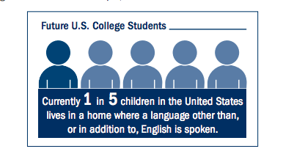
Postsecondary Enrollment Patterns Suggest a Growing Proportion are English Learners
Immigrant and language minority students make up an estimated 25% of the 2.6 million community college students in California (Llosa & Bunch, 2011).
An estimated 46% of the 91,000 students enrolled in the City University of New York’s community colleges are not native English speakers (City University of New York, 2011).
(Bergey, Movit, Baird, & Faria, 2018)
As the United States gets more racially and ethnically diverse, the proportion of students who speak English as a second language is likely to increase.
Notes:
In 2016, 13% of immigrants were ages 5 to 24, suggesting a large number of immigrants may enroll in K-12 and higher education systems (Census Bureau).
In 2016, 49.1% of immigrants report speaking English less than “very well” (Census Bureau).

Slide 6
Methodology for Literature Review
Topic | Number of Articles Found | Number of Articles used for Review
Assessment and placement of ELs | 21 | 10
EL Identity | 4 | 3
ESL institutional practice and policy | 42 | 6
ESL outcomes | 28 | 25
ESL policy | 24 | 15
ESL student experience | 8 | 8
ESL theories of action | 18 | 17
High school context | 18 | 16
Identification and labeling of ELs | 14 | 13
Instructional Delivery/Course Structure/ Pedagogy | 37 | 18
Learning processes | 15 | 4
Transition to college | 8 | 4
Grand Total | 237 | 139
Interviews with experts in the field of ESL from K-16 levels
Literature identification
Search terms
Date limits
Databases
Journals
Selection criteria
Date limits
Peer reviewed
Types of research
Descriptive work
Correlational studies
Rigorous outcomes studies
Notes:
6 interviews? Interviews led to areas of interest – search terms

Slide 7
Methodology for Qualitative Analysis
Site visits at two colleges in CA
Interviews with administrators, ESOL and English faculty, and college staff
Student focus groups and classroom observations of ESOL, developmental English, and college-level English courses
Survey administered to students enrolled in advanced ESOL courses

Slide 8
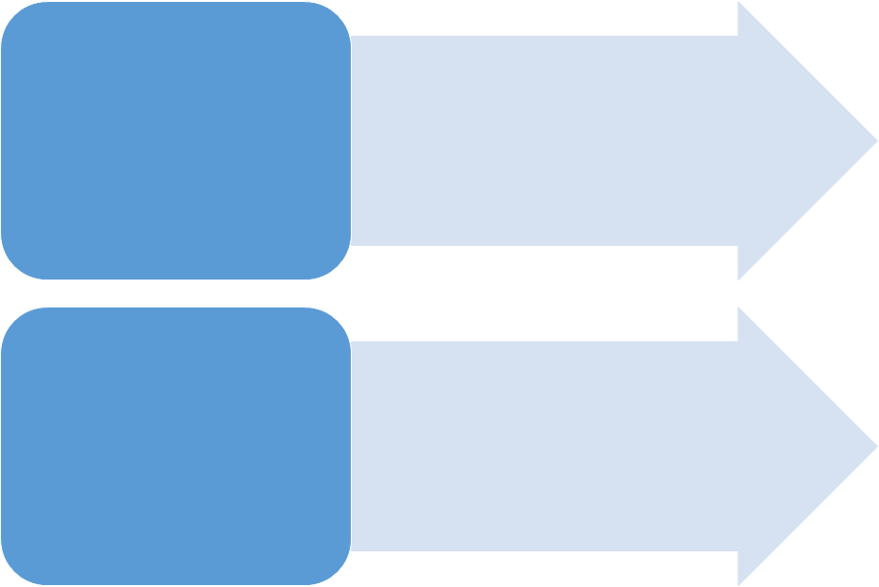
California Policy and Program Context
Education Code §78213 (d)(1)(B) states that colleges “must maximize the probability that. . . a student enrolled in ESL will enter and complete degree and transfer requirements in English within three years.”
Implementation Deadline: Fall 2020
AB 705
Focus on increasing the number of students who go on to complete transferable gateway courses in English and math
Placement revisions, course acceleration, and math pathways

Slide 9
ESOL Reforms in CA College District
11,500 total students enrolled at college
96% of survey respondents born outside of U.S.
Survey data shows most students had intention of earning an Associate’s degree.
College L
7,000 total students enrolled at college
90% of survey respondents born outside of U.S.
Survey data shows most students had intention of transferring to a four-year college.
College B
Notes:
Total survey sample
BCC: They were 25% Caucasian; 15% African American; 22.7% Asian-Pacific Islander; 25% Latino; 7% Multiple Race/Ethnicity; 4% declined to state; and less than 1% American Indian/Alaska Native. Berkeley City College students’ average age is 26 years, with more than half between 19 and 24 years of age.
Laney demographics:

Slide 10
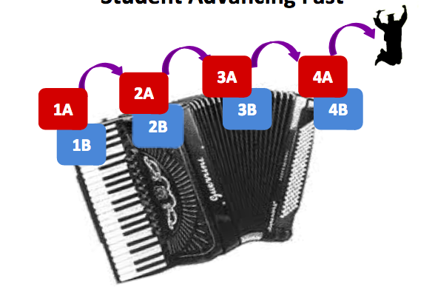
Accelerated Accordion Model
Notes:
. COHORT at Laney So anyway, um, what we did was we created this pathway where I take the grammar class and speaking/listening classes that are normally in one semester and I stretch them out to two semesters. So, the students stay in their group, in their cohort, with me as the teacher for two semesters. And they learn all the content that's normally taught in one semester.
And then, the two semesters allow them to complete Grammar 1 and Speaking/Listening 1. And so then afterwards - and at the same time they are taking Rebecca’s class and another teacher’s classes on Friday. So I’m with the group like two days a week and then on Friday they go to the class where they learn computer skills and vocabulary and pronunciation skills that are all tied to what I’m teaching in my classes during the week.
Q: Okay.
A: And, um, then they would go to the higher level class like the level two class after they leave my class.

Slide 11
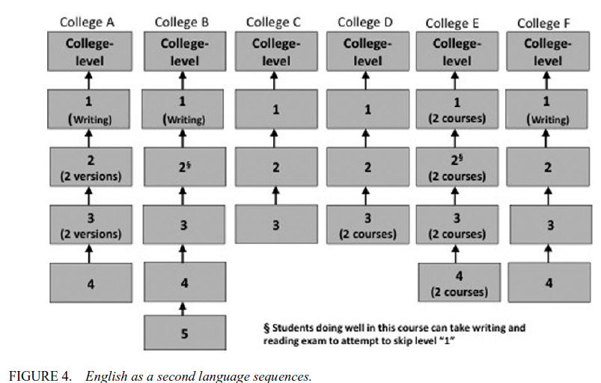
Traditional ESL Course Sequences in Community Colleges
Source: Hodara, 2015
Notes:
Rodriguez et al. (2017) found that in California community colleges “no single assessment is used by a majority of colleges to assess the ESL skills of incoming students” (p. 15).
Relying on a single standardized test score for ESL placement could lead to misplacement.
The field lacks consensus on what is the most valid measure for English proficiency.
Problems with placement systems and instruments exacerbate challenges encountered by ELs in transitioning to college.
Issues around messaging and information-sharing shape student placement experiences (Harklau, 2008; Biber, Conrad, Reppen, Byrd & Helt, 2002).
Course can discretely focus on reading, writing, vocab, grammar, listening/speaking skills

Slide 12
Curriculum and Instruction in Traditional ESL Courses
Use of “remedial pedagogy” in traditional ESL classrooms (Grubb, 2013)
vs. multi-layered view of language and literacy (Ivanič, 2004).
Curricular depictions of international student rather than U.S.-educated linguistic minority student (Harklau, 2000).
vs. materials from which students can draw personal connections (Harklau, 2000).
Need for English language instructional support outside of ESL (Bunch, forthcoming).
Notes:
the curriculum discussion seems to be vearing toward cultural relevancy. The pedagogy conversation has less clarity on an affirmative approach ("best practice") but Grubb et al.'s work gives us a picture of what we want to get away from. I also think there's a tension worth raising: while we know these sequences are long and losing students, we don't know how long it takes for an entering CC student to become academic English proficient (and it's reasonable to presume the time will vary by student). As George's new work emphasizes, we also don't have much in the area of EL support outside of ESL, suggesting the need to think about English language teaching and learning broadly -- particularly for institutions serving a lot of ELs.

Slide 13
EL Identity in Community College
Dimensions of institutional culture can have negative impacts on EL student identity:
Multilingualism is perceived as a liability, not an asset.
Students resist being grouped into a homogenized ESL student category.
Institutional labels and representations impact how ELs negotiate their identity as learners.
Notes:
(Harklau, 2000)
Institutionalized “ESL” label
Also, positive impacts on students’ experiences: (Harkalu, 2000)

Slide 14
Case Studies of ESOL Reform Approaches and the Experiences of English Learners

Slide 15
Alimatou, 29, Advanced Grammar ESOL course
“I have already my [degree] in Senegal and I, when I come here, I would like to make a change to know better and to like be more professional. That’s why I chose this program. And I took ESL first and my certificate class and it was like so hard because I do not understand right away what the teacher saying in class. But I used my dictionary to translate words to help me understand better. And right now I’m taking English five.”

Slide 16
Characteristics of Students Enrolling in ESOL Courses
Table 1: Immigration Characteristics
 | Frequency | Percentage
Born outside of the United States | 51 | 92.7%
Born in the United States | 4 | 7.3%
Total | 55 | 100.0%
Length of residency in the United States
< 1 year | 8 | 15.7%
1–3 years | 28 | 54.9%
4–6 years | 9 | 17.6%
7–10 years | 3 | 5.9%
10+ years | 5 | 9.8%
Total | 51 | 100

Slide 17
Characteristics of Students Enrolling in ESOL Courses
 | Frequency | Percentage
Race
White | 7 | 12.7%
Asian | 33 | 60.0%
Latino/Hispanic | 10 | 18.2%
Black | 1 | 1.8%
Other | 3 | 5.5%
Prefer not to state | 1 | 1.8%
Total | 55 | 100.0%
Gender
Female | 38 | 69.1%
Male | 17 | 30.9%
Total | 55 | 100.0%
Dependents
No dependents | 33 | 60.0%
Dependents | 22 | 40.0%
Total | 55 | 100.0%
Employment status
Not employed | 32 | 58.2%
Employed | 23 | 41.8%
Total | 55 | 100.0%
Hours working (if employed)
1–20 hours | 11 | 50.0%
21–40 hours per week | 9 | 40.9%
Over 40 hours per week | 2 | 9.1%
Total | 22 | 100.0%

Slide 18
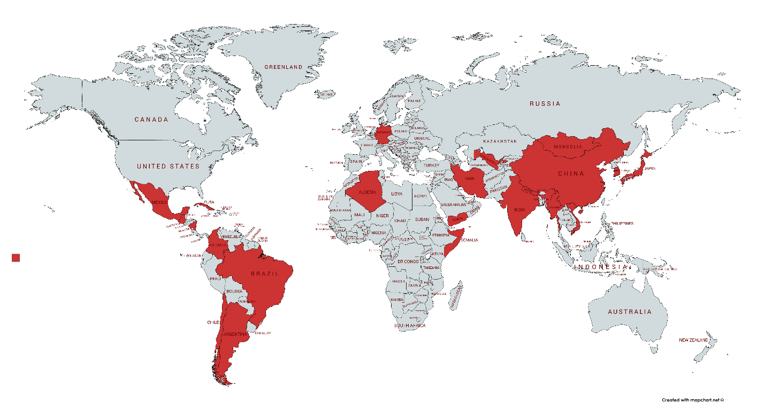
Characteristics of Students Enrolling in ESOL Courses

Slide 19
Academic decision-making among students in ESOL tied to confidence with English skills
“I found some students, they have, they worried that if they chose a major, they worry that English would be, but, when I chose accounting, I found that if you’re not already reaching the high intermediate ESOL, you already can choose the major. Because you can understand the teacher. You can do that. But, some students say that no, I can’t. I need to finish all the ones.”
Notes:
Several of the students in our data described a similar rationale for enrolling in ESOL courses - an overwhelming need to learn not only conversational, but also academic English (in terms of academic and writing skills).
Students who express a desire to master written and grammatically proper English see these skills as related to their future academic and professional success - and, as such, an important factor in what they choose to study and the careers they choose to pursue. For example, one student described his plans to open his own business. This student felt ESOL courses were right for him because he will need to “speak and communicate in English.” He added, “I want to learn to proper, in proficiently way,” clarifying how important it was for him that his communication skills are accurate. Similarly, another student felt that she needed “like the best vocabulary I can get” to understand the natural practices that she is planning to study to pursue a career in “alternative therapy.”
Our data offer some insight into why ESOL students see proper English language skills as a requisite to academic and professional success. One student explained the issue in terms that suggest the student felt that her peers lacked confidence in their language capabilities. The student said,

Slide 20
Classroom experiences of ESOL students heavily influenced by faculty practices
“When I was a university student in Japan, it kind of almost teacher just begin in writing and memorizing. Where here it's totally different. We get to talk each other. And we get to writing my opinion for the teacher.”

Slide 21
ESOL students engaging with the community college
Importance of Intake Processes
“…when I met [the counselor], she just look at the things and she said that you selected ESL later and I find out that there’s a difference between English than ESL. The issue that I was expecting these guys to get me some explanation about it it’s good if you start English better for us and what I’m thinking of like if we wanted to complete a degree in two years and two and a half years so if you are adding more subjects so it’s going to be going up to three and a half years.”
Notes:
“...students are required to make an appointment with a counselor after they get the results of their tests. And that's where I think that that interface between the counselors and the teachers I think is really critical because I don’t think the counselors are trained to - I mean sometimes I think they are seduced by a student who is fluent by they are fluently wrong. And so frequently I have - so often a student comes to class and they say well, this is where the counselor told me to go. But they are just so misplaced.”

Slide 22
ESOL students engaging with the community college
“and then the students are required to make an appointment with a counselor after they get the results of their tests. And that's where I think that that interface between the counselors and the teachers I think is really critical because I don’t think the counselors are trained to - I mean sometimes I think they are seduced by a student who is fluent but they are fluently wrong. And so frequently I have - so often a student comes to class and they say well, this is where the counselor told me to go. But they are just so misplaced.” –ESOL Instructor
Notes:
Laney challenges.

Slide 23
ESOL students engaging with the community college
Integration of ESOL students in the institution
“But we never have like introduction like come from like hi, you’re a student. Not only ESL student, but a student. But, it would be nice to have like a tradition that you feel that you belong to this school. Cause I feel like I more belong to ESL groups and ESL course than I do belong to the [college].”

Slide 24
Community College Research Center Teachers College, Columbia University 525 W 120th St. | Box 174 | New York, NY 10027 Raufman@tc.edu

Slide 25
Notes:
Join CCRC and MDRC in November for the CAPR conference. Registration opens in April. Sign up for the CAPR mailing list at postsecondaryreadiness.org to get information about the program and registration.

